Slide 1

User Interface E-Gate Pass
Web Development
SFPO research

Slide 2
Progress UI
revision request | Page | revision request | Page
Modul EHS
Modul Logistic
Open
Open

Slide 3
Feedback List
Feedback request | Depart | Page | Feedback Request | Depart | Page | Feedback Request
Possible search on dropdown list |  |  | Make Category gatepass base on type of goods |  |  | Change layout of approval invormation
Possible edit gatepass after rejected |  |  | Add bilingual Feature |  |  | Possible manually, kevin driver name
Possible filtering data when generate carriage letter |  |  | Add Photo upload option on truck & goods
Add Cost Center dropdown |  |  | Possible search gate pass base on type of goods
User possible print gatepass |  |  | Make dropdown list on type of goods for Finish goods
General gate pass control by each depart |  |  | Change Returned Record Table view base on type of goods
Page
Open
Open
Open
Open
Open
Open
Open
Open
Open
Open
Open
Open
Open
Open

Slide 4
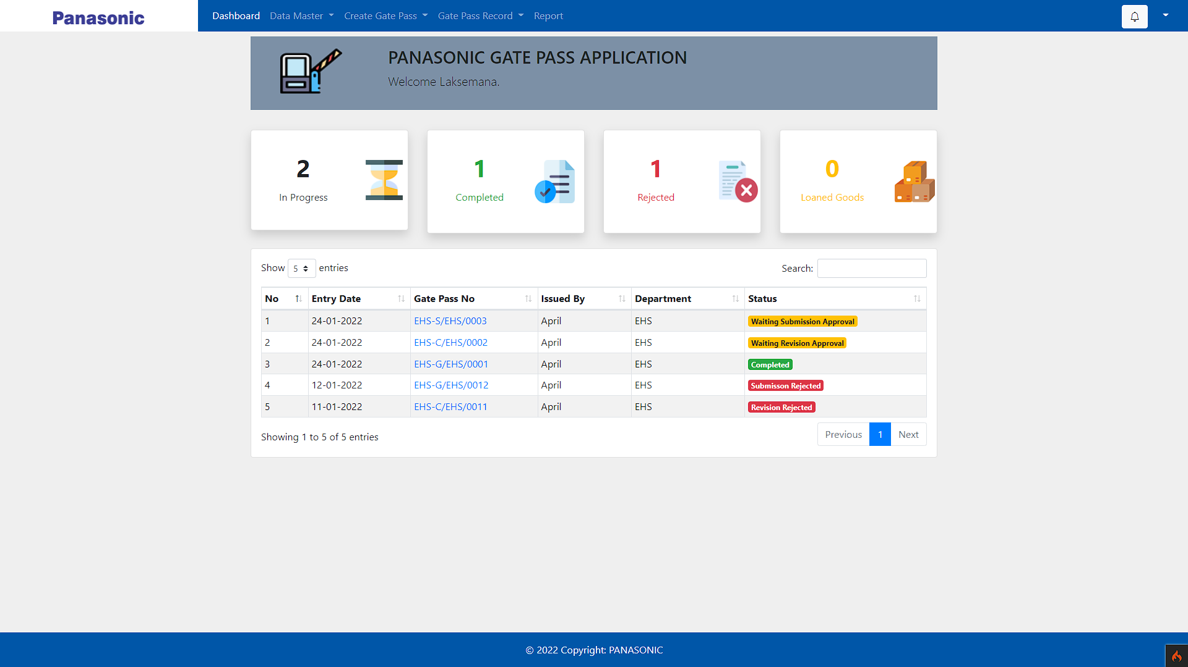
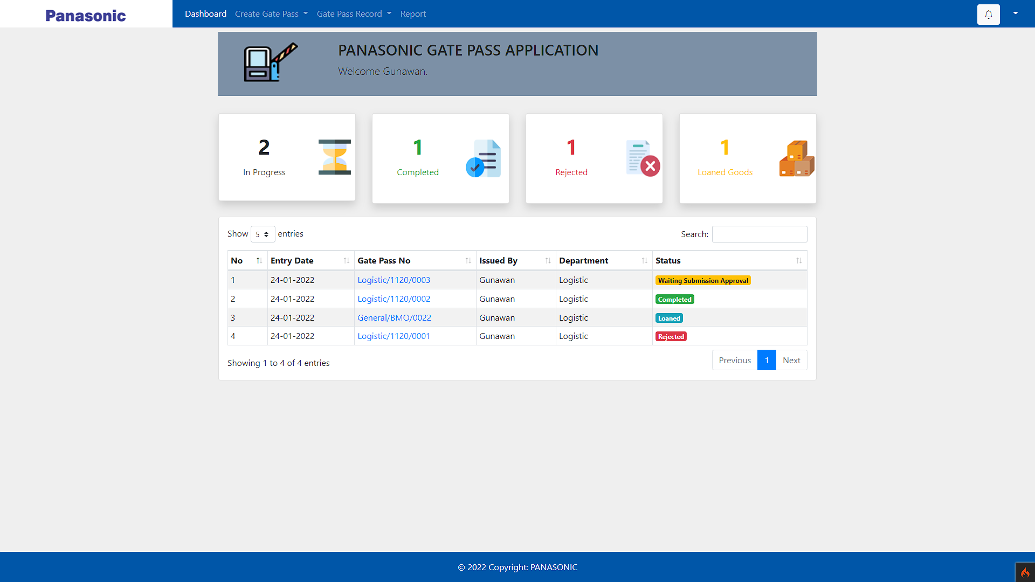
Modul Logistic

Slide 5

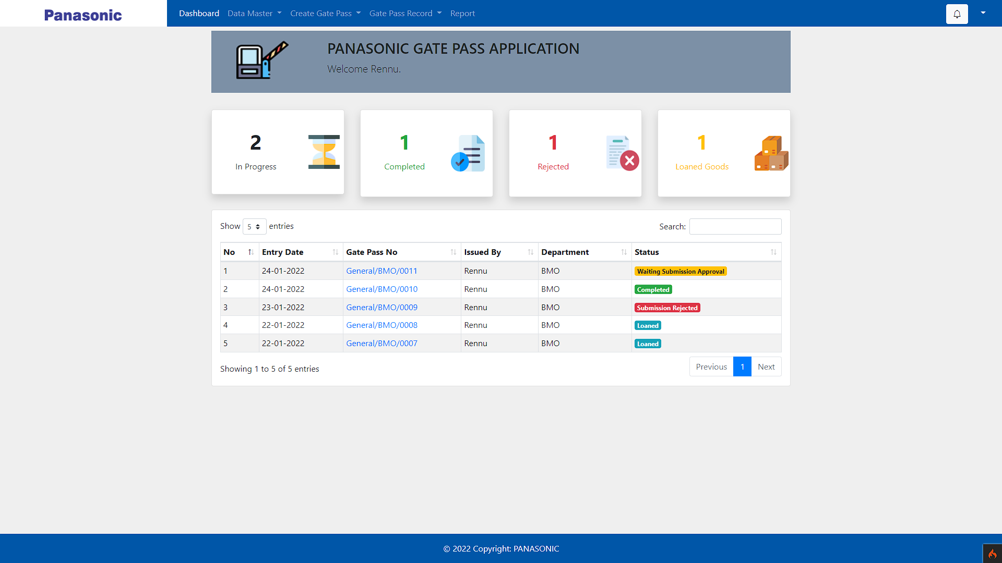
Modul BMO

Slide 6
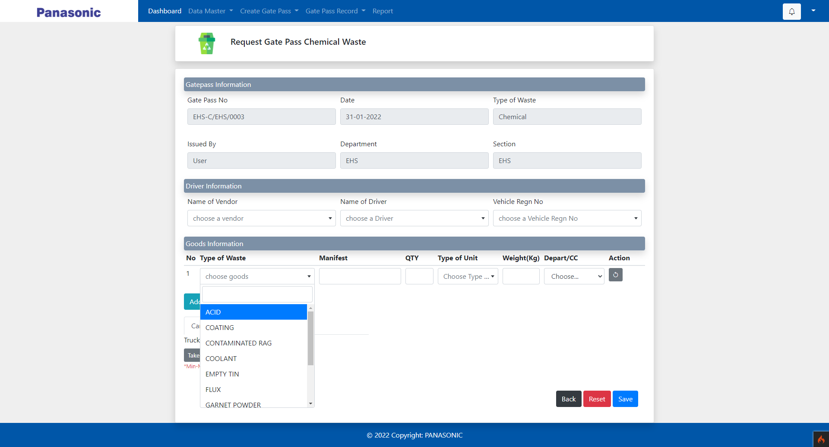
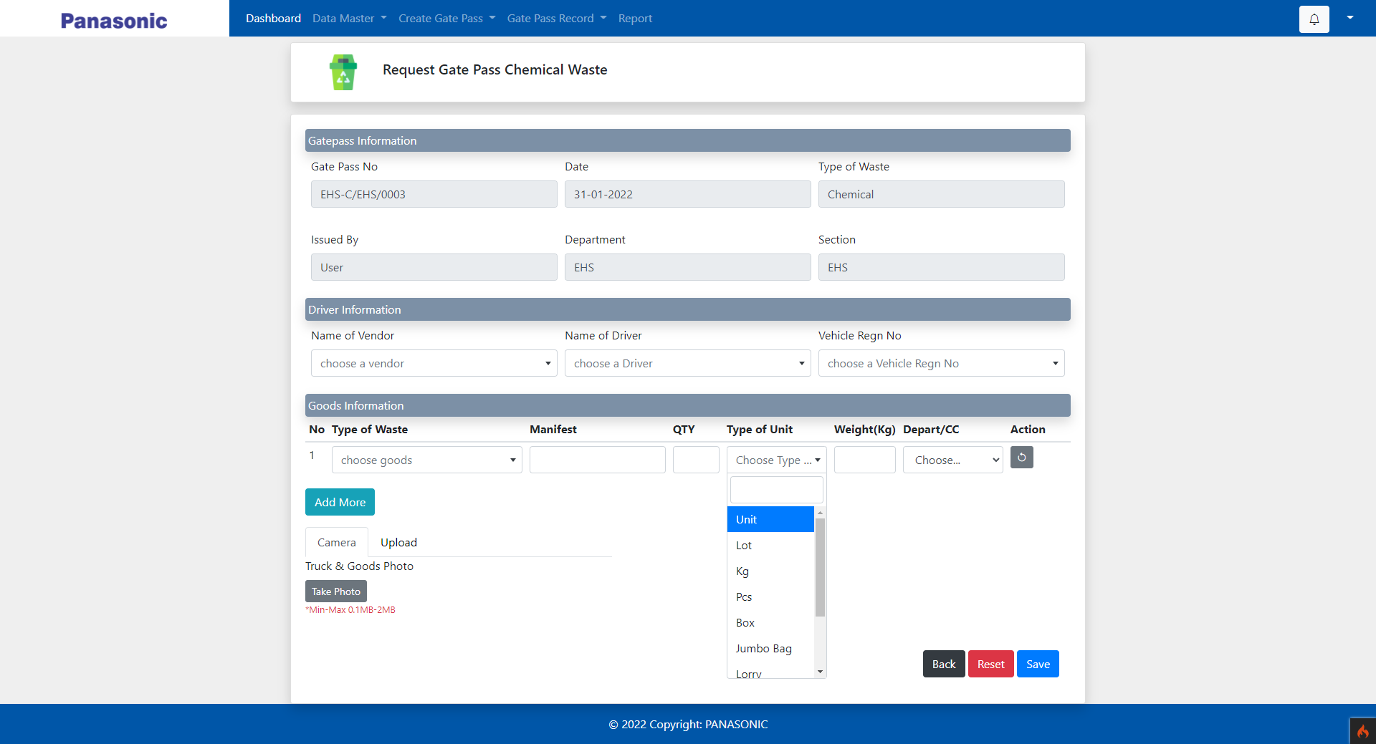
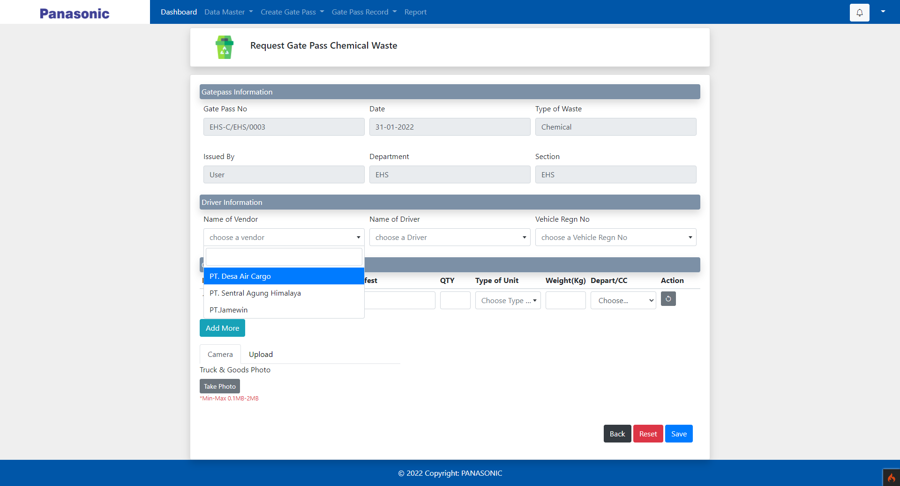
search on dropdown list

Slide 7
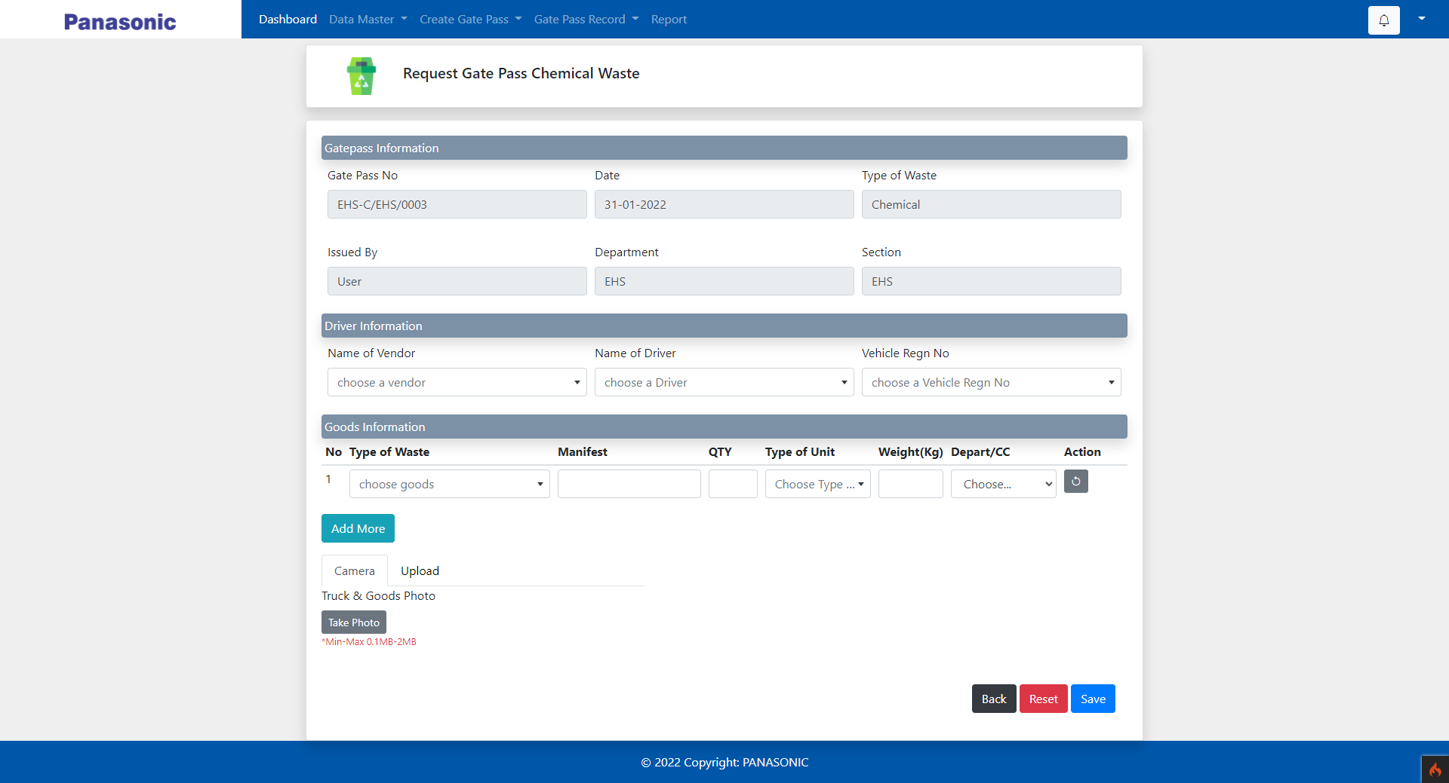
Add Photo upload option
on truck & goods

Slide 8
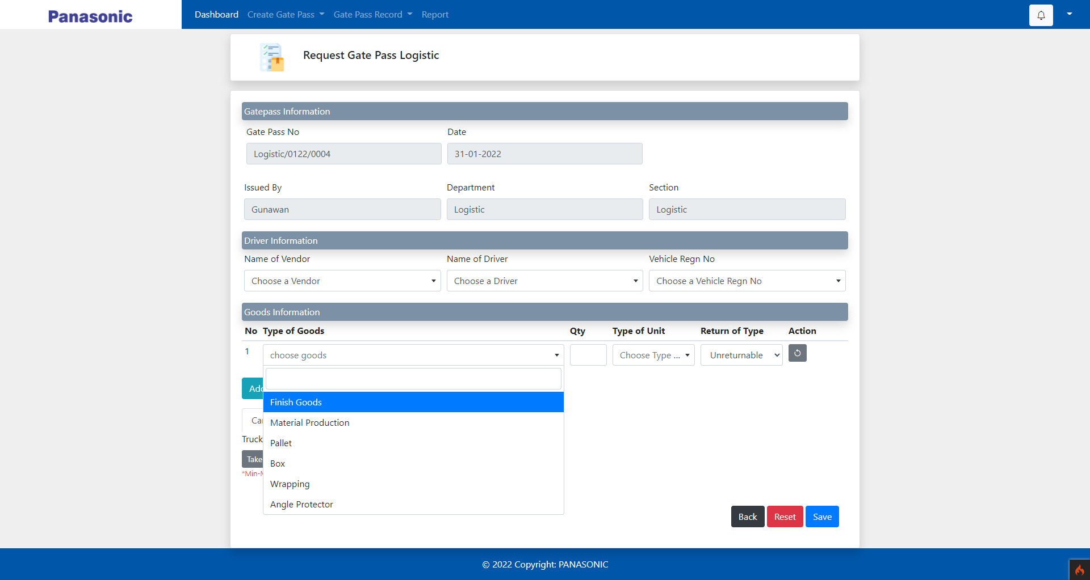
Make dropdown list on
type of goods for Finish goods

Slide 9
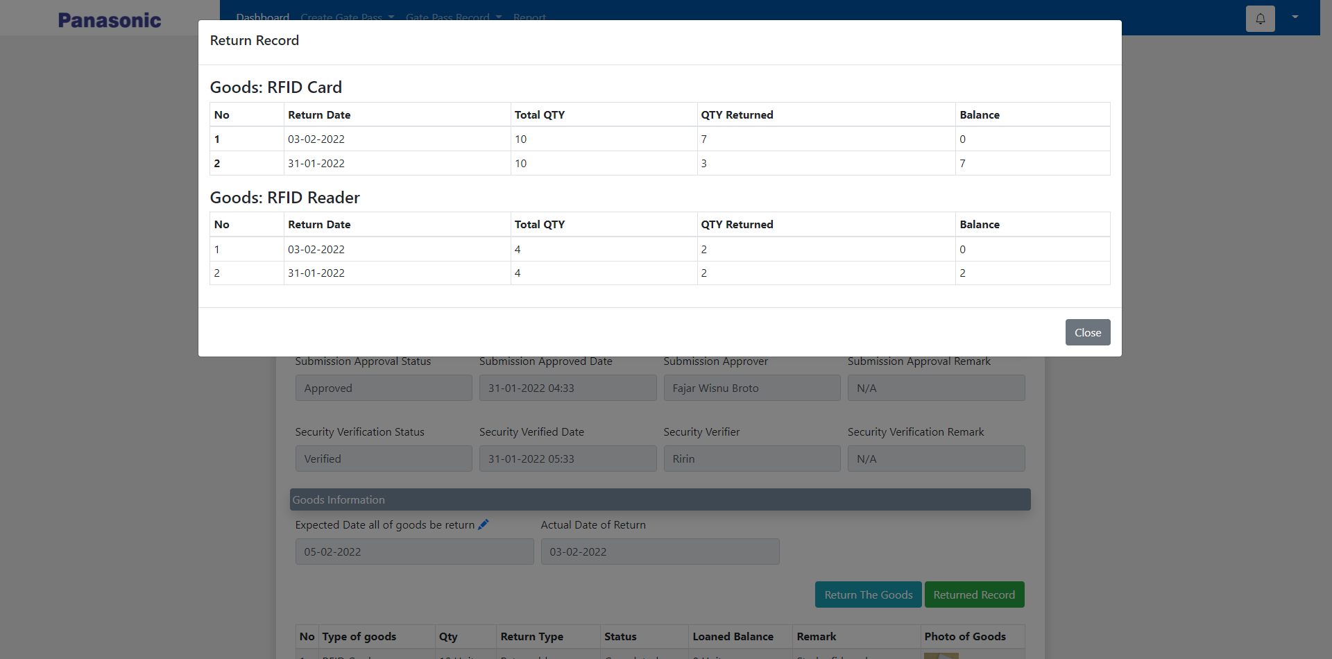
Change Returned Record Table
view base on type of goods

Slide 10
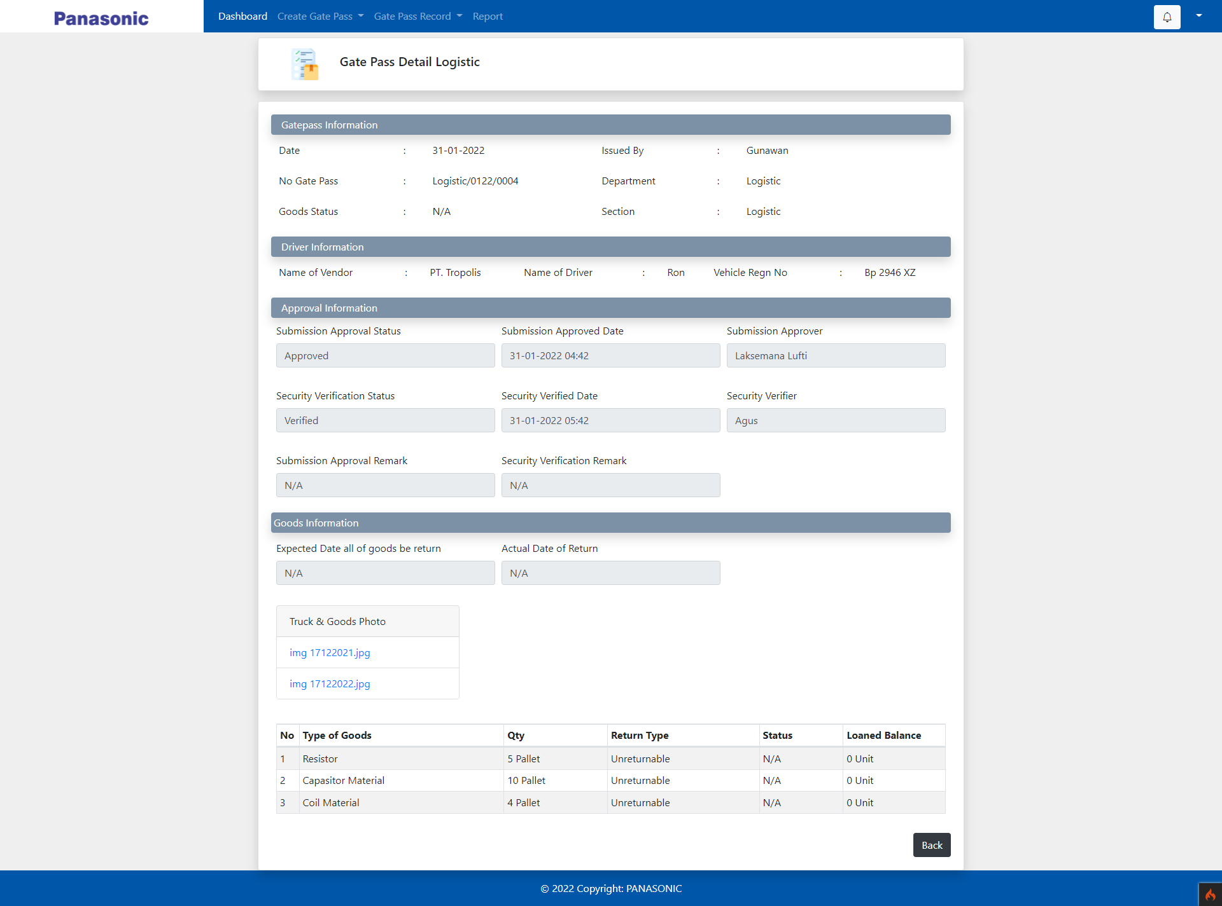
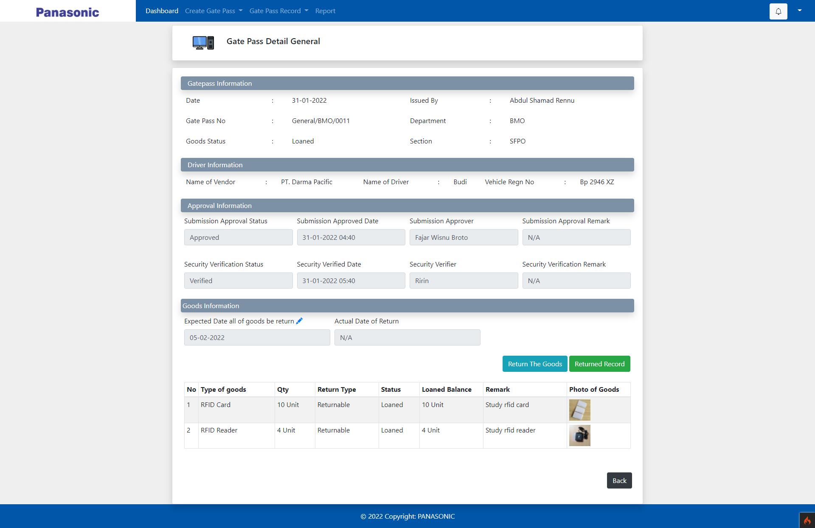
Change layout of
approval invormation

